Slide 1




Adani stocks’ Performance :An Event study approach
S Balaji
22381056
Department of Banking Technology

Slide 2
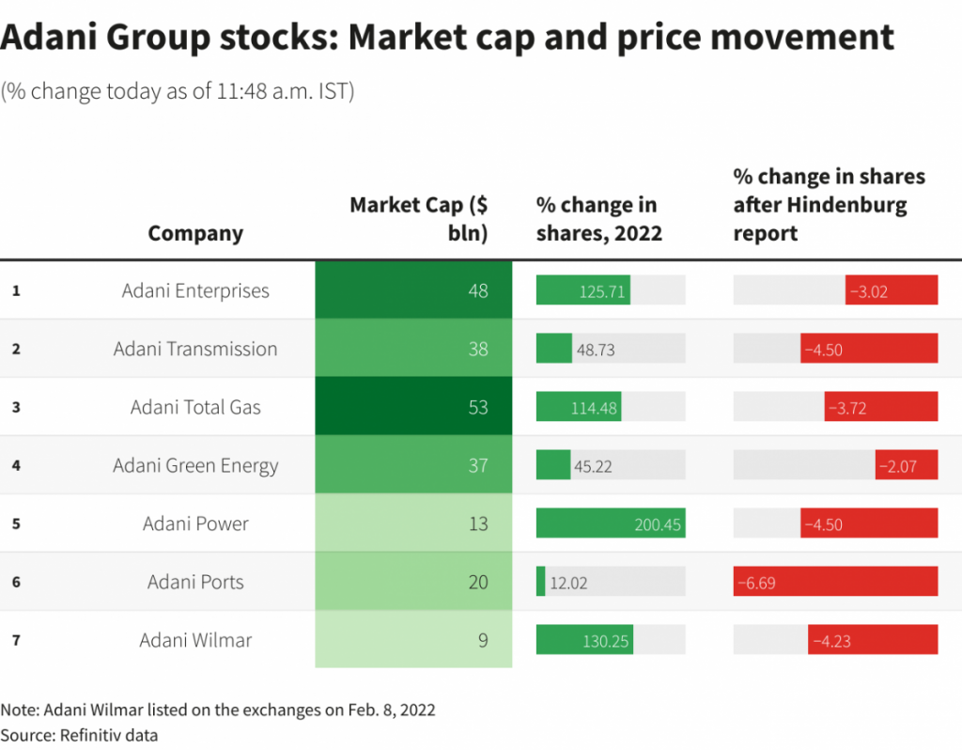
Introduction
In the beginning of 2023, Hindenburg short seller who came out with the report on Adani Stocks.
That report triggered tremendous changes in the adani stock prices.This is one of the classic example of market efficiency.
However, a study considering a complete analysis of loss and resilience of the Adani stocks will be impulsively useful for investors community.
Hence, this study attempts to have an thread bear analysis over the Adani stock by taking two event (i.e) the day of Hindenburg report release and supreme court: Verdict.

Slide 3
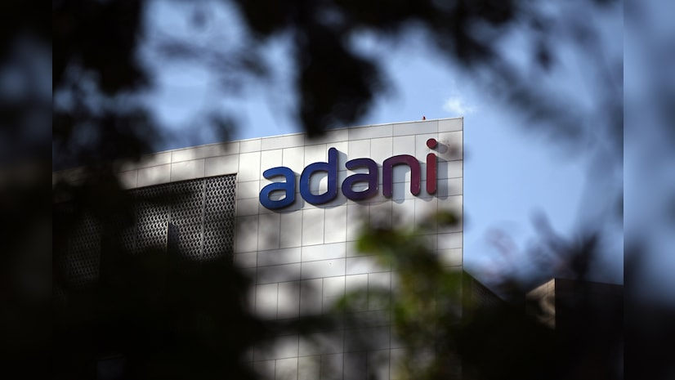
About Adani Group
Adani Group is a diversified organization in India comprising 9 publicly traded companies. It has created a world class transport and utility infrastructure portfolio that has a pan-India presence. Adani Group is headquartered in Ahmedabad, in the state of Gujarat, India. Over the years, Adani Group has positioned itself to be the market leader in its transport logistics and energy utility portfolio businesses focusing on large scale infrastructure development in India with O & M practices benchmarked to global standards.
Adani owes its success and leadership position to its core philosophy of ‘Nation Building’ driven by ‘Growth with Goodness’ - a guiding principle for sustainable growth.

Slide 4

About Hindenburg
Hindenburg Research LLC is a U.S. investment research firm with a focus on activist short-selling founded by Nathan Anderson in 2017. Named after the 1937 Hindenburg disaster, which they characterize as a human-made avoidable disaster, the firm generates public reports via its website that allege corporate fraud and malfeasance.
Companies that have been the subjects of their reports include Adani Group, Nikola, Clover Health, Block, Inc., Kandi, and Lordstown Motors. These reports also feature defenses of the practice of short-selling and explanations of how short-sells can "play a critical role in exposing fraud and protecting investors."

Slide 5
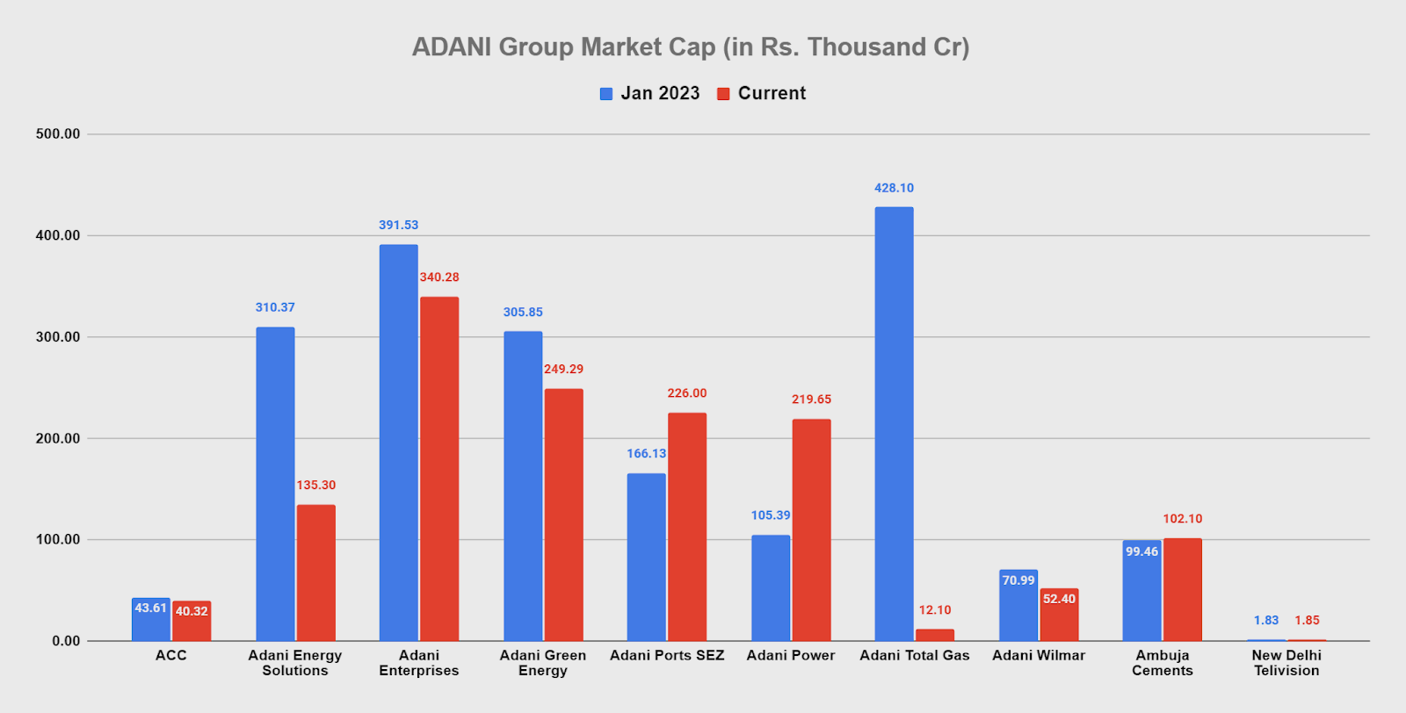
Objectives
To assess the impact of the Hindenburg Research Report on Adani Group Stocks
To analyze the effects of specific events on a company's stock price
To provide valuable insights to investors and the general public

Slide 6
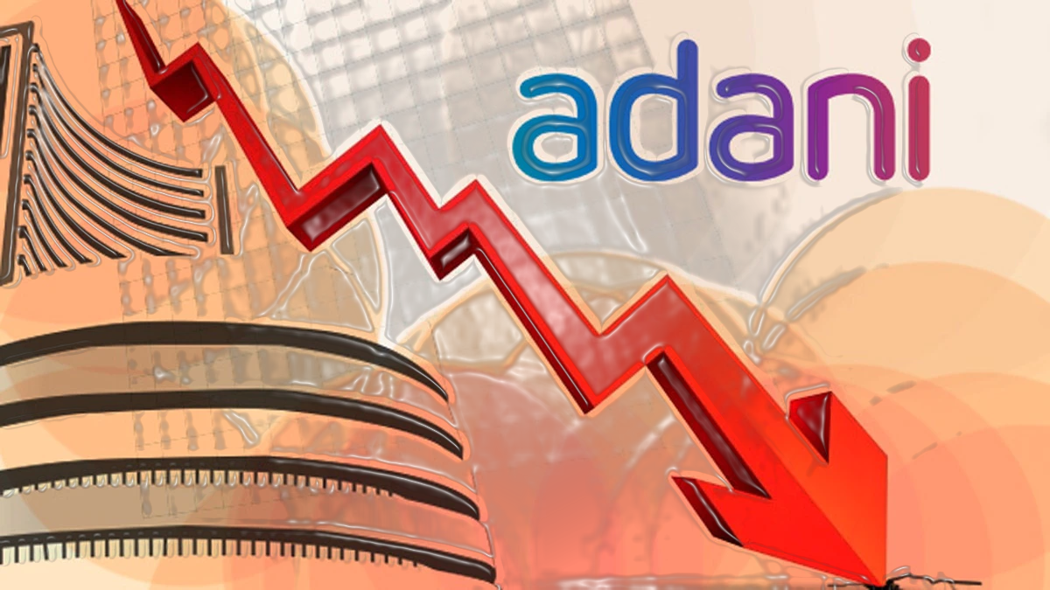
Key Findings
The study on the impact of the Hindenburg Research report on Adani Group stocks revealed a significant 60% decline in the combined market value of the group, amounting to approximately $146 billion, following the report's release on 24 January 2023. The report had a magnified impact on Adani Group's stocks, leading to investor fear due to serious allegations of accounting fraud and stock manipulation. Employing an Event-Based Study Approach, the research aimed to quantify the decline in share prices post-release, analyzing stock returns and assessing the recovery trends of Adani Group's subsidiaries. This study provided valuable insights into stock price effects associated with unexpected events, offering crucial information on how financial news influences financial markets' dynamics to various stakeholders.

Slide 7
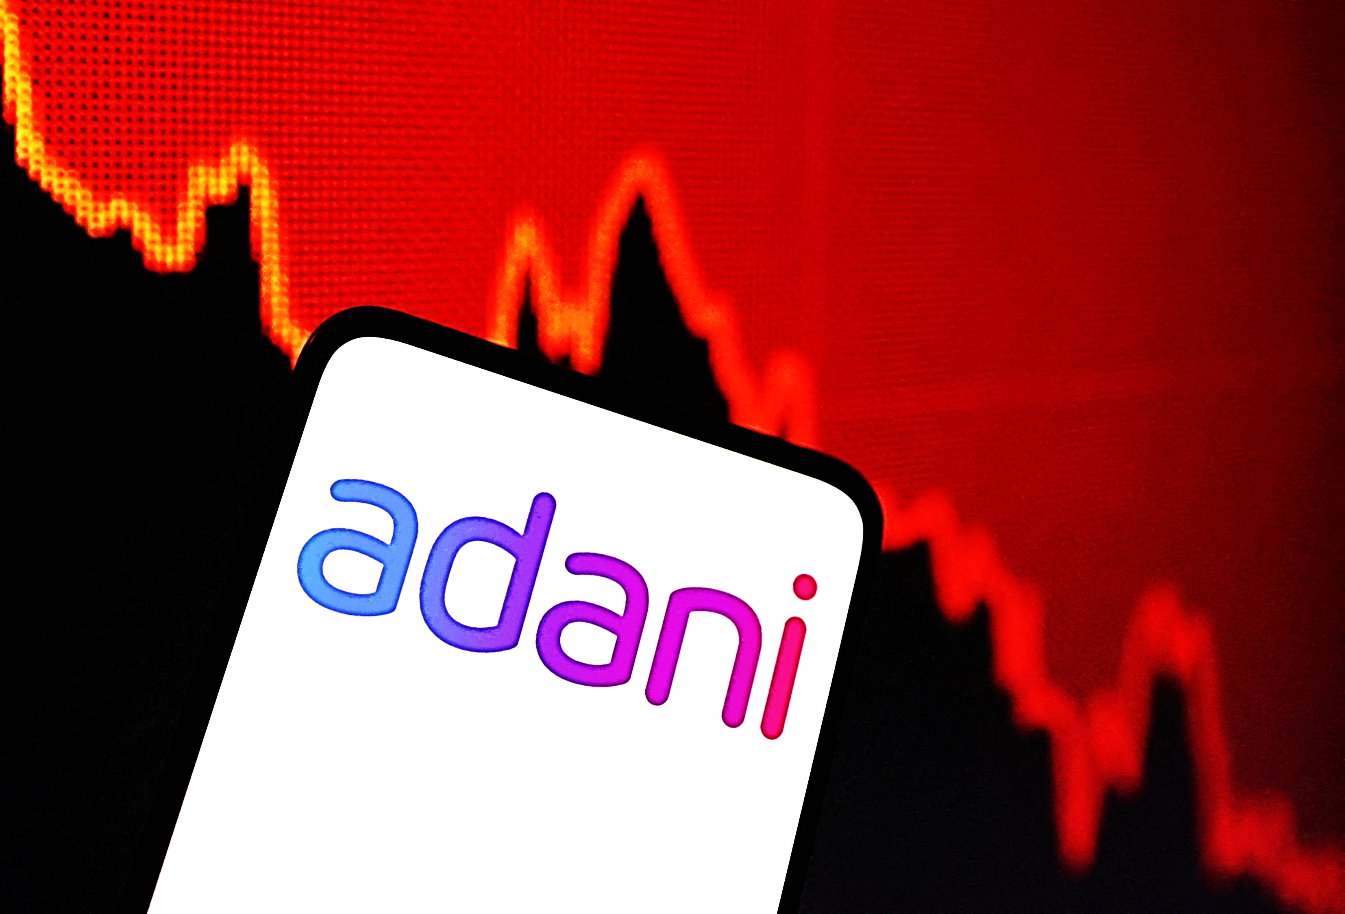
Problem statement
When the Hindenburg report exploded on Jan 24, 2023 Adani group lost Rs 5.6 lakh crore in just three trading days of the release of the report. The project aims to conduct an event analysis of Adani Group stocks, compare the performance of stocks before and after the Hindenburg research report, as well as assess the Supreme Court verdict. Therefore, I want to study the impact of Adani group stocks and the current status by the event study approach.

Slide 8
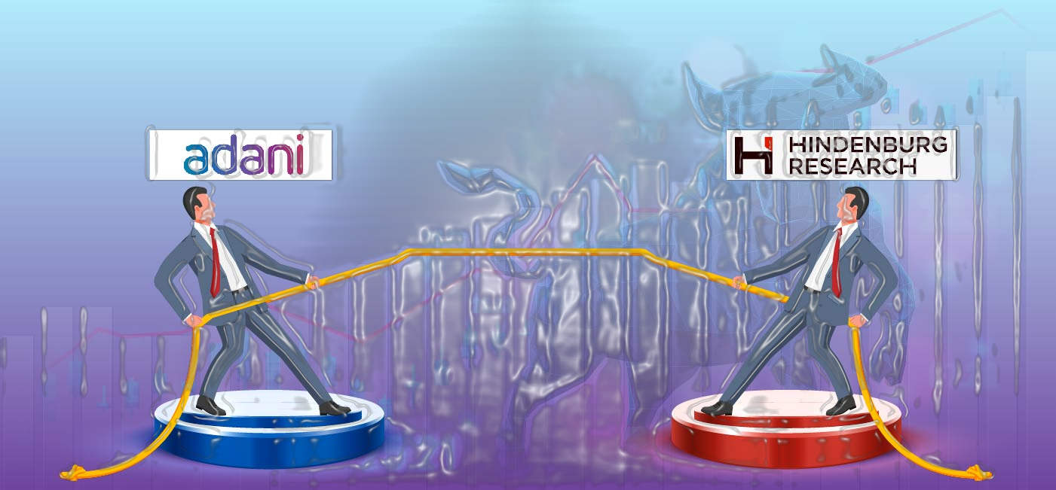
Research Gap
Even though stringent market regulation are in place. Across the globe, there are charges leveled against global corporate firms like Hindenburg, a short seller made a allegations on Adani stock that, Adani group have done the manipulations in order to increase the stock prices artificially.
However, Adani companies have been given clean chit by the competent authorities.
However, it’s a need to study the loss of shareholders wealth and resilience of Adani stock performance. No previous study has attempted to verify this dimension. Hence, this study will fill the gap.

Slide 9
Literature review
Giannetti and Wang (2016) studied the effect of Corporate Scandals on the stock market. the researcher has considered Arthur Andersen LLP Accounting Firm for their study. The firm was accused of shredding various documents of its client Enron and it was known as Enron Scandal. After this scandal, the US stock market experienced very little participation from Arthur Andersen's clients in the market.
Anwar et al. (2017) studied the impact of the announcement of cash dividends on the stock prices of Indian manufacturing companies. The researchers have considered the manufacturing companies listed on BSE. The study concluded that the announcements of cash dividends have a significant effect on abnormal average returns. The research also explored the effect of the US Financial crisis on the Indian Stock Market
Richardson et al. (2022) studied the impact of accounting fraud on future stock prices. The researchers have considered 51,492 U.S. companies during the study period from 2000 to 2014. The study concluded that accounting fraud does have a negative effect on the stock prices of the companies.
Mallesha and Archana (2023) studied the impact of the Hindenburg Research Report on the stock prices of the Adani Group of Companies. The researchers have conducted an Event Study with a 21-day event window. The research showed that the average abnormal return and cumulative average abnormal return are statistically significant during the whole event window. It also revealed that the Hindenburg Research Report does have an impact on the stock prices of the Adani Group of Companies. It is also being observed that the stock prices of Adani Group did not perform according to the release of the report.

Slide 10
Conclusion
The study of this research aims to analyze the before and after impact of the Hindenburg Research Report and the Supreme Court: verdict to investigate under SEBI, which showed up on price action of the company stocks. This helps bounce back of the Adani Group and the trust of an investors.
Hence, the shareholders must be aware of the companies before investing their hard-earned money into the share market.

